Slide 1
Cloud Based Attendance System
Sevinj Abdullayeva | OE NIK
Cloud computing services II

Slide 2
Outline
1
Introduction
2
Objective
3
Blob storage
4
Storage accounts, Containers, Blobs
5
Implementation

Slide 3
Introduction
The attendance is considered as an important factor for both the student and the teacher of an educational institution. Checking an attendance is the most effective way to improve a student’s attendance rate in a class. There are two kinds of attendance checking system that an institute can choose from
Most of the educational Institutions use the manual attendance checking system by calling names or passing around a sign-in sheet. It is time consuming and requires a lot of effort.
Traditionally, the manual attendance system
Automated attendance system

Slide 4
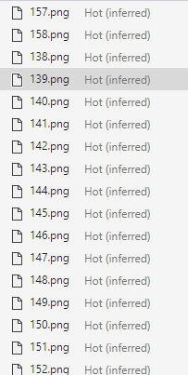
OBJECTIVE
In this project, I proposed face recognition based cloud attendance system that can identify students and store their face images into Azure Cloud.
The main working principle of the proposed project is that video captured data is converting into images in order to detect and recognize the faces and the collected images will be storing in azure blob storage. Later, the system marks attendance with the student's recognized image; otherwise, the system marks the student's attendance to the database as absent.

Slide 5
What is Azure Blob storage?
Azure Blob storage is Microsoft's object storage solution for the cloud.
Blob storage is optimized for storing massive amounts of unstructured data.
Notes:
Unstructured data is data that doesn't adhere to a particular data model or definition, such as text or binary data.

Slide 6
Blob storage is designed for:
Storing data for analysis by an on-premises or Azure-hosted service.
Serving images or documents directly to a browser.
Streaming video and audio.
Storing files for distributed access.
Writing to log files.
Storing data for backup and restore, disaster recovery, and archiving.

Slide 7
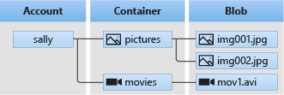
Blob storage resources
Blob storage offers three types of resources:
A blob in a container
The storage account
A container in the storage account

Slide 8
A storage account provides a unique namespace in Azure for our data. Every object that we store in Azure Storage has an address that includes our unique account name.
Storage accounts
A container organizes a set of blobs, similar to a directory in a file system. A storage account can include an unlimited number of containers, and a container can store an unlimited number of blobs.
Containers
Azure Storage supports three types of blobs:
Block blobs store text and binary data.
Append blobs are made up of blocks like block blobs, but are optimized for append operations.
Page blobs store random access files up to 8 TiB in size.
Blobs
Notes:
A storage account provides a unique namespace in Azure for our data. Every object that we store in Azure Storage has an address that includes our unique account name. The combination of the account name and the Blob Storage endpoint forms the base address for the objects in our storage account.
A container organizes a set of blobs, similar to a directory in a file system. A storage account can include an unlimited number of containers, and a container can store an unlimited number of blobs.
Azure Storage supports three types of blobs:
Block blobs store text and binary data. They are made up of blocks of data that can be managed individually.
Append blobs are made up of blocks like block blobs, but are optimized for append operations. Append blobs are ideal for scenarios such as logging data from virtual machines.
Page blobs store random access files up to 8 TiB in size. Page blobs store virtual hard drive (VHD) files and serve as disks for Azure virtual machines.

Slide 9
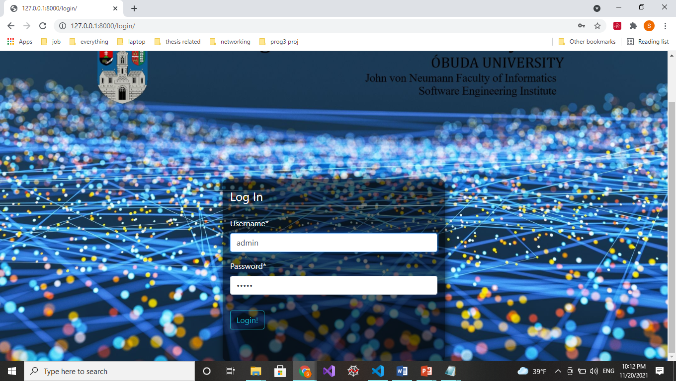
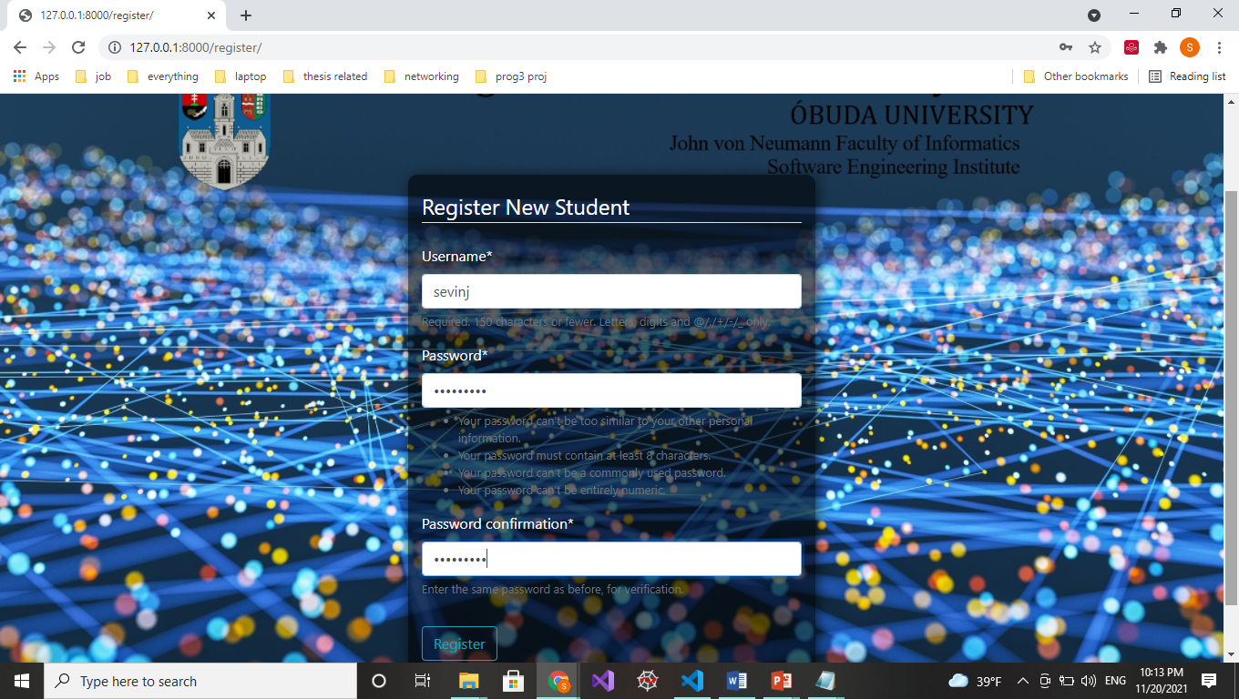
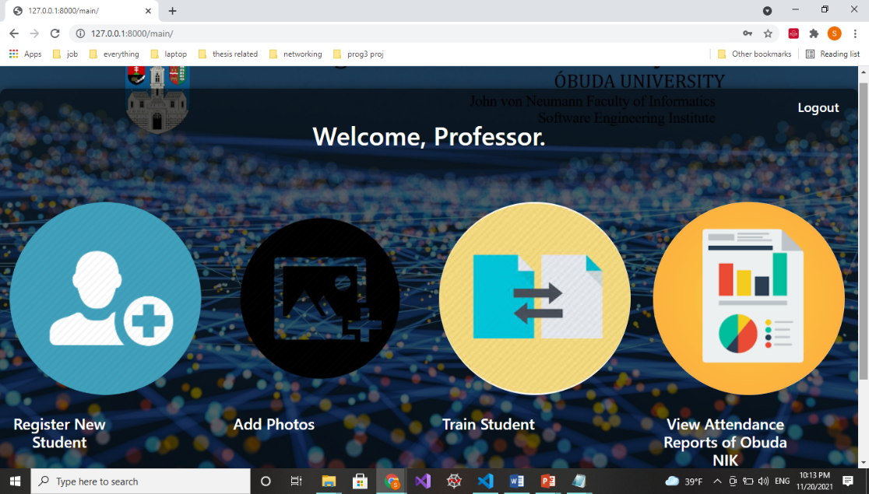
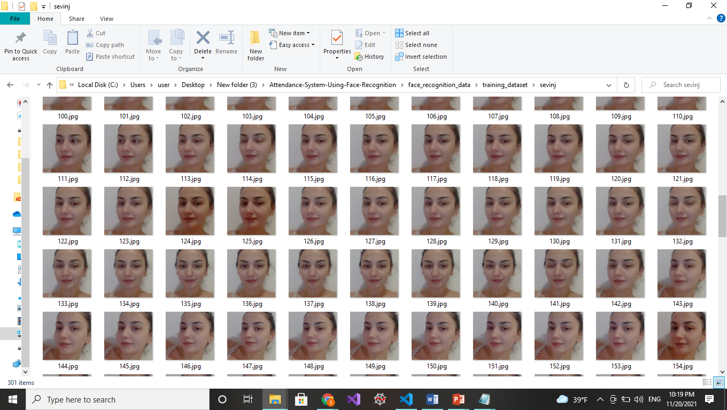
Implementation
First, the admin of the system; a teacher can add new student by registering the new student, filling up their registration details and collect their face data to upload into Azure storage.

Slide 10
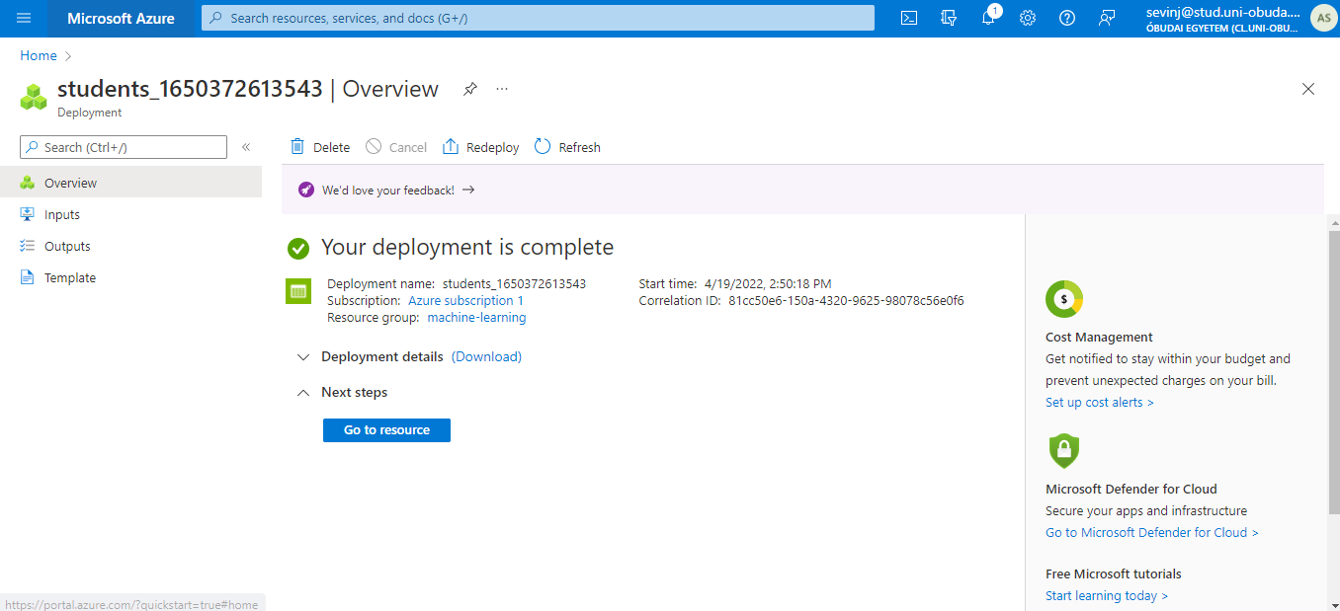
Implementation
The first step in using Azure Storage is to create a storage account.

Slide 11
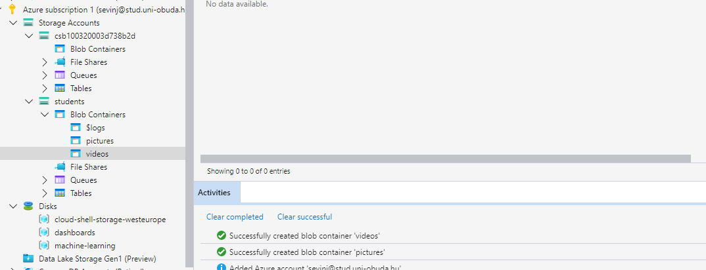
Implementation
Before we create a blob, we must create a container to store it in.

Slide 12
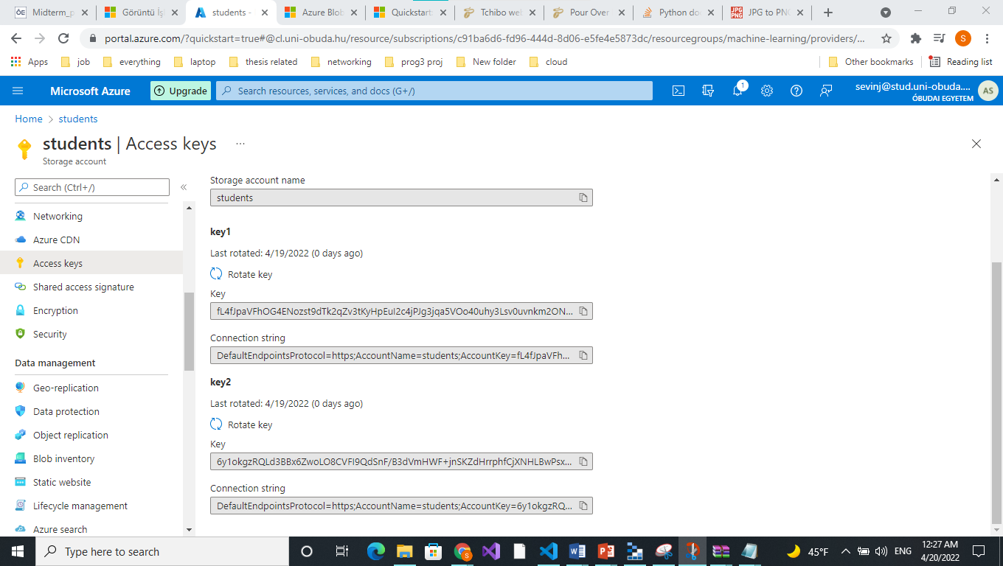
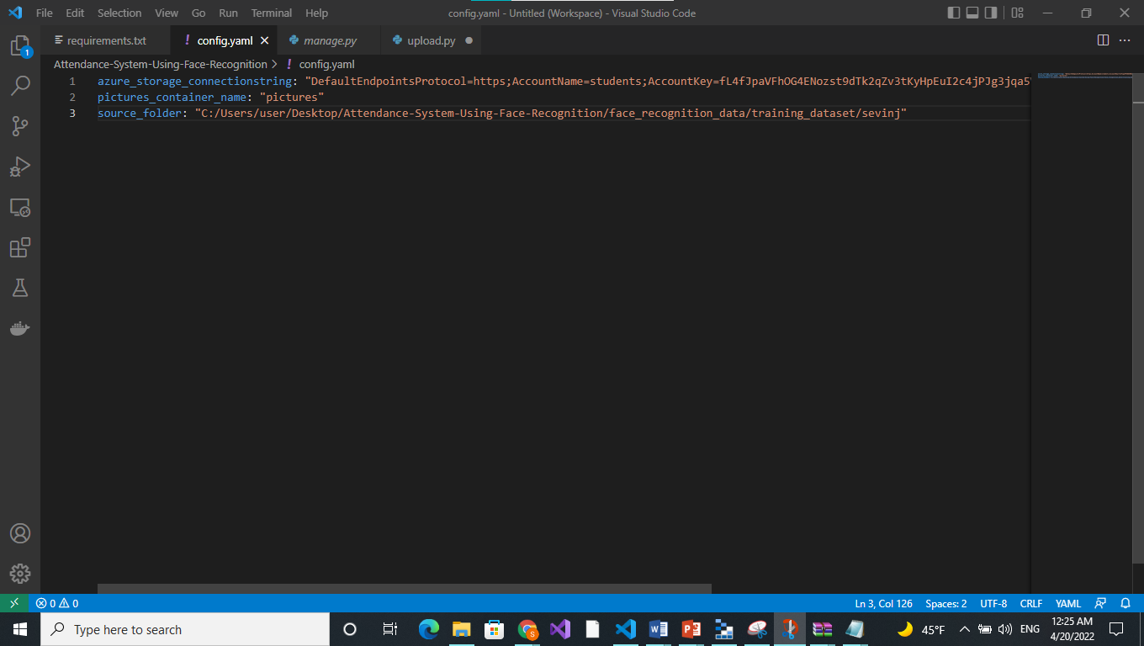
Implementation
And we can finally Upload Collected Images to Azure Blob Storage

Slide 13
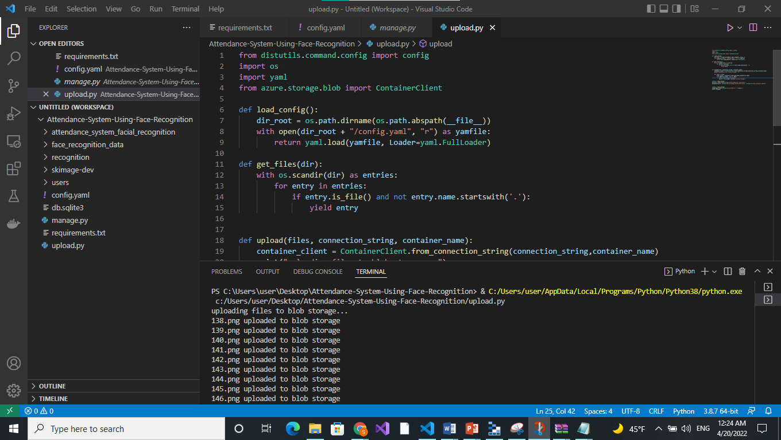
Implementation

Slide 14

Now we can return to the Microsoft Azure Storage Explorer, click the “pictures" container under the storage account we created and see the uploaded pictures here. We can also download the blobs and see the pictures stored in the blob.

Slide 15
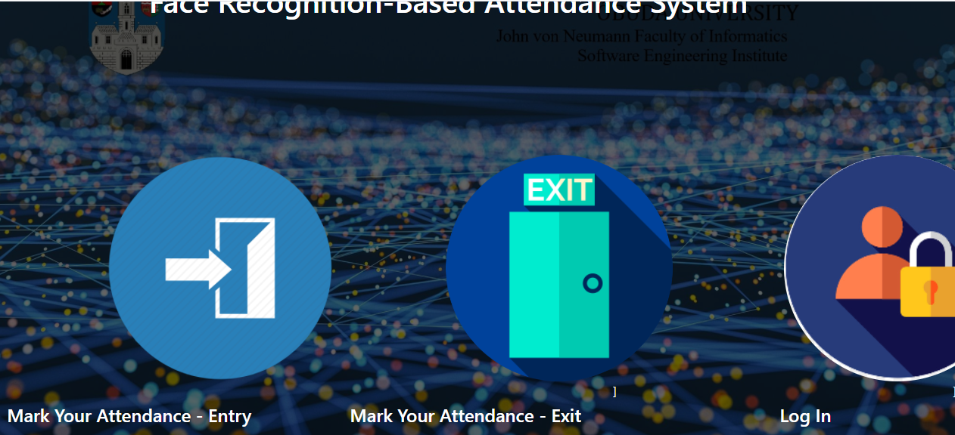
Later, the student has to login and record their faces to mark their attendance.
And the admin is authorized to view the records of all the students. This system allows to keep up to date record of the students.

Slide 16
Advantages
The database is secured as it is stored in an Azure BLOB storage.
You can add/remove/change data transactionally.
Needs active internet connection.
Disadvantages

Slide 17
THANK YOU!

